Slide 1

PROCESS MINING VIRTUAL INTERNSHIP
by
N.KESHAVA NAIDU
Roll No. 214G1A32A6
Department of Computer Science and Engineering (Data Science)
Srinivasa Ramanujan Institute of Technology
(Affiliated to JNTUA & Approved by AICTE) (Accredited by NAAC with ‘A’ Grade & Accredited by NBA (EEE, ECE & CSE)
Rotarypuram Village, B K Samudram Mandal, Ananthapuramu – 515701.
2023 - 2024

Slide 2

Contents
Course Objective
Introduction
Technology
Applications
Modules
Real Time applications
Learning outcomes
GitHub Link
Queries

Slide 3
Course Objective
Process Mining Virtual Internship course is to teach you about Process Mining Techniques and how to apply them in real world scenarios.
You will learn how to analyze and improve business processes using data-driven approaches , ultimately enhancing operational efficiency and effectiveness.

Slide 4
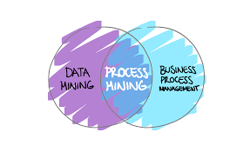
Introduction
What is Process Mining?
Process mining is a data-driven approach that aims to discover, analyze, and improve real business processes using information extracted from event logs.
Process mining starts with process discovery, where algorithms analyze event logs to generate process models that represent the actual sequence of activities, decisions, and interactions within a process.

Slide 5
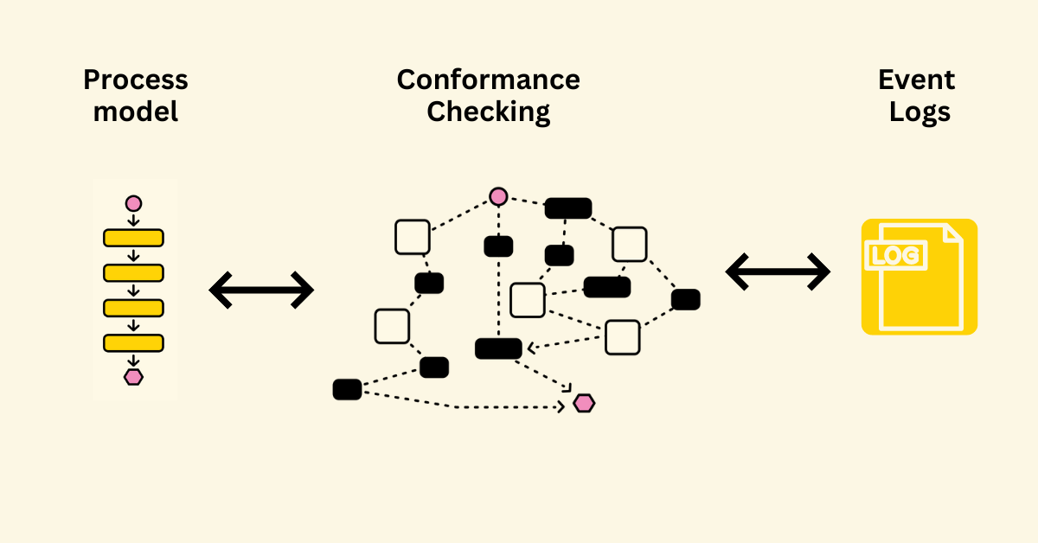
Technology
Conformance Checking: After the process is discovered, the actual process execution can be compared with the intended or designed process to identify any deviations. This helps organizations understand how well their processes are being followed and where exceptions occur.

Slide 6
contd..
Performance Analysis: Process mining enables the analysis of process performance metrics such as cycle time, waiting times, and resource utilization.
Process Discovery: process discovery is where the event logs are analyzed to automatically reconstruct and visualize the actual process flows.
Data Collection and Event Logs: Event logs are collected from IT systems , capturing timestamps , activities, participants, and other relevant details.

Slide 7
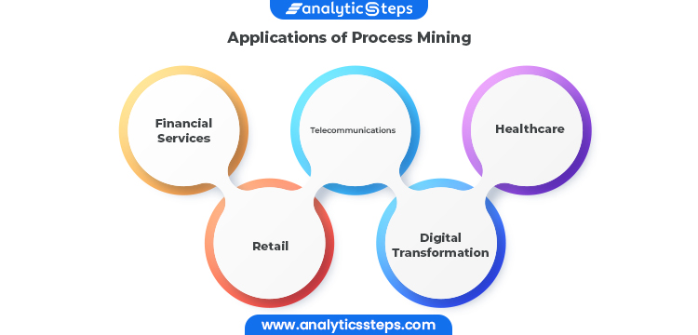
Applications
Financial Process Analysis: Financial institutions can use process mining to analyze processes like loan approvals, claims processing, and compliance procedures. This ensures to regulations, reduces fraud, and enhances process transparency.

Slide 8
contd...
Logistics and Transportation: Process mining can help optimize logistics and transportation processes, such as route planning, fleet management, and delivery tracking, leading to reduced transportation costs and improved delivery times.
Human Resources Management: Process mining can help HR departments analyze employee onboarding processes, performance reviews, and other HR-related processes. It can highlight areas for streamlining and improving employee experiences.

Slide 9
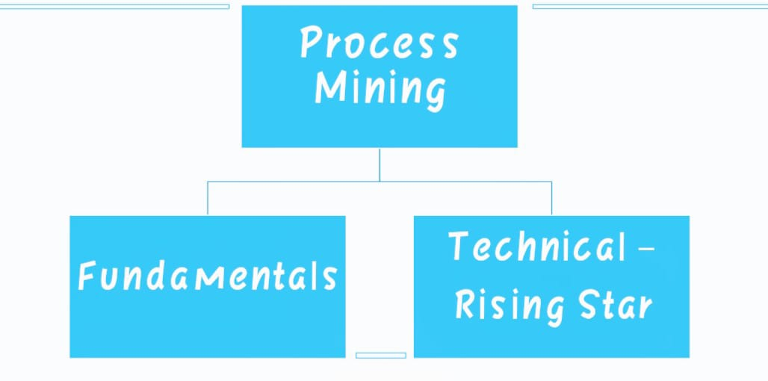
Modules

Slide 10
contd..
Fundamentals in Process Mining:
Data Preprocessing: Event logs might contain noise, incomplete records, or irrelevant data. Data preprocessing involves cleaning, filtering, and transforming the event log data to ensure accurate and reliable analysis.
Visualization Techniques: Process mining results are often visualized using diagrams like process maps, Gantt charts, and heatmaps. These visualizations make it easier to communicate findings and insights to stakeholders.

Slide 11
Real Time Examples
Here are some real-time examples of how process mining can be applied in various industries and scenarios:
Manufacturing : A manufacturing plant wants to optimize its production line. Process mining can help analyze the entire production process, from raw material intake to finished product output.
Customer Service : A customer service center wants to enhance its customer support process. Process mining can track customer interactions, ticket handling times, and resolutions.
Healthcare Process Optimization: In healthcare, process mining can be applied to analyze patient care processes, such as hospital admissions, treatment procedures, and discharge processes.

Slide 12
contd..
Public Transportation:
A public transportation agency employs process mining to analyze bus and train schedules. They identify factors causing delays in service and implement adjustments to improve reliability and punctuality.
Loan Approval in Banking:
A bank employs process mining to analyze loan application processing. They uncover steps that cause delays in application approval, allowing them to reduce customer wait times and improve customer satisfaction.
Insurance Claims Processing:
Tracking the steps involved in processing insurance claims, including documentation, assessment, and payment. Process mining can help identify areas for automation.

Slide 13
Learning Outcomes
Through process mining, we will learn how to create visual representations of processes using techniques like process maps, flowcharts, and activity diagrams.
Whether in business, healthcare, or other fields, the skills you acquire through process mining have real-world applications that can lead to improved efficiency, reduced costs, and enhanced outcomes.

Slide 14
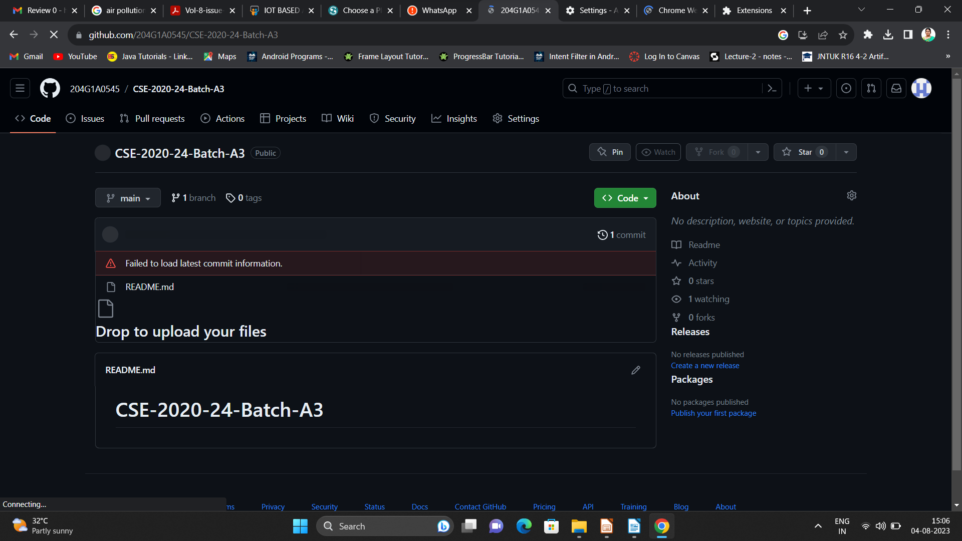

Git Hub Dashboard
Repository Name Like: Summer Internship - I
Under that include document, presentation and Certificate(Pdf).

Slide 15
Any Queries?

Slide 16
Thank You!!!

